Slide 1

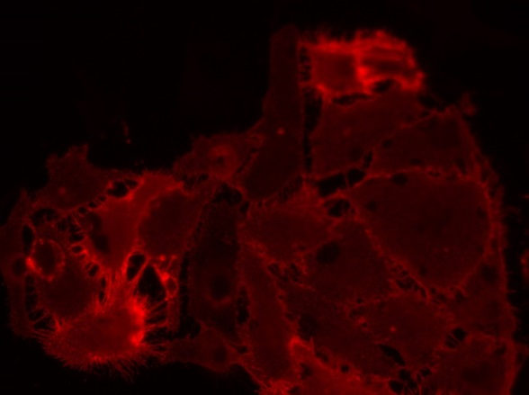
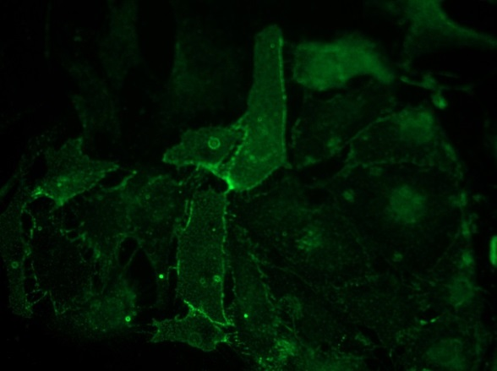
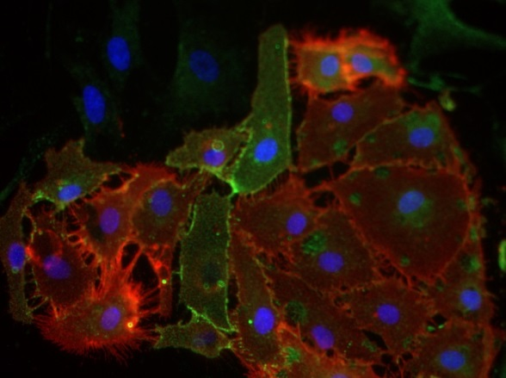
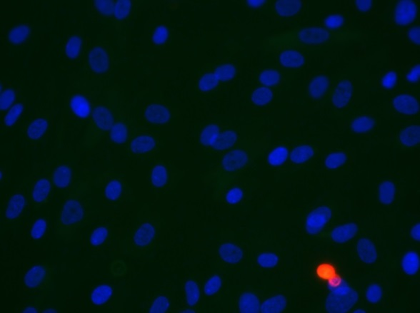
ReliaTech GmbH
Rabbit anti-human ESAM / mouse anti-human CD31 #WM-59
mouse anti-human CD31
rabbit anti-human ESAM
CD31 / ESAM
Control (goat anti-rabbit IgG ALEXA Flour 488; 1:600
Goat anti-mouse IgG-PE; 1:400)
Immunofluorescence staining of CD31 (red) and ESAM (green) in a mixture of primary human dermal lymphatic endothelial cells (HDLEC) and human dermal normal fibroblasts with monoclonal mouse anti-human CD31 #WM-59 [Cat# 101-M92] rabbit anti-human ESAM [Cat# 102-PA42AG]. Control with goat anti-rabbit ALEXA Flour 488 [Dianova], 1:600 and goat anti-mouse IgG-PE [Santa Cruz], 1:400). [IF_NHDF1406-02; 101-M92 / 102-PA42AG (2 / 5µg/ml), 400X]
http://www.reliatech.de / info@reliatech.de

